Slide 1





Slide 2
Contents
Introduction
Problem Solving Agents
Search
Example problems
Traveler's route finding problem (Travelling Romania)
8-Puzzle & 8-Queen
Missionaries & Cannibals
Route Finding Problem

Slide 3
Contents
Uninformed (Blind) Search
BREADTH-FIRST Search
UNIFORM-COST Search
DEPTH-FIRST Search
DEPTH-LIMITED Search
Iterative Deepening Depth-First Search
Bidirectional Search

Slide 4
Introduction
An agent need to plan for finding a sequence of actions that form a path to a goal state.
The agent is called problem-solving agent.
The computational process it undertakes is called search.
We will discuss problem solving agent, searching approaches to get solutions with examples.

Slide 5
Problem Solving Agents
The agent follows four phase problem solving processes:
Goal formulation: The agent adopts the goal such that it possible to organize the behavior by limiting objectives and the action sequences to be considered.
Problem formulation: The agent devices a description of the states and actions necessary to reach the goal.
Search: The agent follows the searching procedure to find the sequence of actions that reaches the goal. The sequence of actions is the solution.
Execution: The agent can execute the actions in the solution one at a time.
In “Task environment” –Solution is a “Fixed sequence of actions”

Slide 6
Searching
The process of looking for a sequence of actions that reaches the goal is called Searching. The solution to any problem is a “fixed sequence of actions”.
A search problem can be defined formally as follows:
State space: A set of possible states that the environment can be in.
Initial state: State from which the agent start in.
Goal states: A set of one or more goal state is defined. Sometimes goal is defined by property.
Actions: The actions available to the agent.
Transition model: A transition model which describes what each action does.
Action cost function: A cost function that gives numeric cost for applying action in one state to another state.

Slide 7
Example problems
Traveler's route finding problem (Travelling Romania)
8-Puzzle
8-Queen
Missionaries & Cannibals
Route Finding Problem

Slide 8
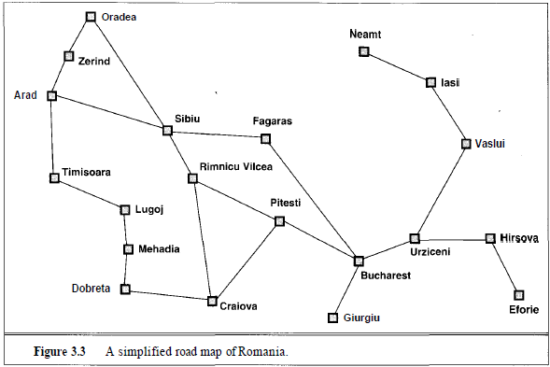
Traveler's path finding problem
(Travelling Romania)
nodes are states
links are actions

Slide 9
Ex – Problem – from Arad to Bucharest (in Romania)
The components defined as
State Space: All the places those are represented as nodes in the graph is called state space.
Initial State: starting state "Arad"
Actions: the edges(roads) represent the actions available for states ‘s’ (places)
Transitions : RESULT (s, a) – Returns the “state reached” after action ‘a’ in state ‘s’ – (Ex: RESULT(In(Arad), Go(Zerind)) = In(Zerind))
Goal state : Goal is “Bucharest“
Path Cost : Length of road in km

Slide 10
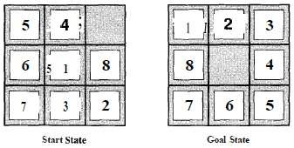
Example Problems – 8 - Puzzle
State – A state desc. specifies the location of 8 tiles & the blank space
Initial State – Any state can be the initial state
Actions – Movement of the blank space Left, Right, Up & Down
Transitions– For a given state & action, this returns the resulting state
Goal Test – Checks if the resulting state matches goal state given below
Path Cost– Each step costs 1 (Path cost is the ‘no. of steps in the path’)

Slide 11
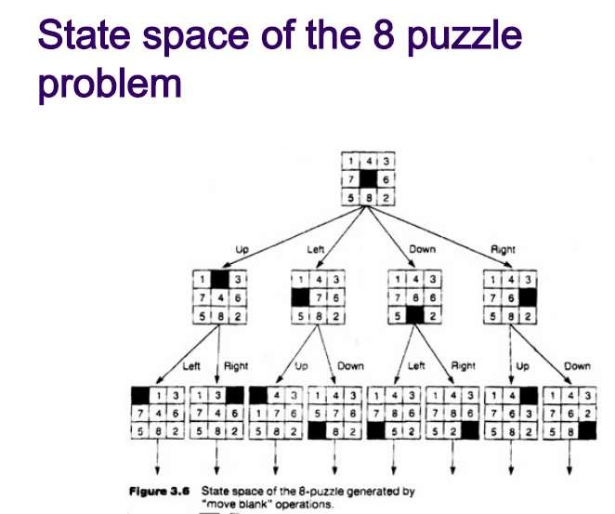

Slide 12
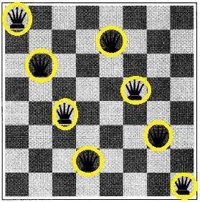
8-Queens problem
Placing 8 queens on a chess board, so that none attacks the other. A queen attacks other queen in the same row, column or diagonals.
State - Any arrangement of 1 to 8 queens on board
Initial State – No queen on the board
Actions - Add a queen to any empty square
Transition Model – Returns the board with a queen added to the specific square
Goal Test– 8 queens on board, none attacked

Slide 13

Missionaries & Cannibals
3 missionaries & 3 cannibals are on one side of a river
The boat can hold 1 or 2 people
⚫
Find a way to get everyone to the other side, without ever leaving a
group of missionaries outnumbered by cannibals
State: (#m, #c, 1/0)
#m - denotes the no. of missionaries in the first bank
#c - denotes the no. of cannibals in the first bank
The last bit - indicates whether the boat is in the first bank (1 stands for boat is in first bank )
Initial state: (3, 3, 1)
Goal state: (0, 0, 0)
m = 0 or m>= c
Actions: Boat carries (1, 0) or (0, 1) or (1, 1) or (2, 0) or (0, 2)

Slide 14
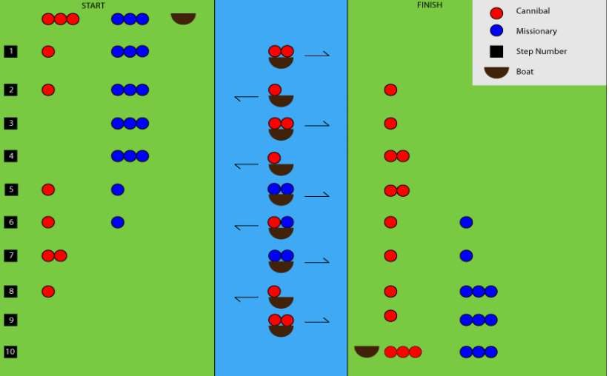
Initial state: (3, 3, 1)
Goal state:
(0, 0, 0)

Slide 15
Real-World Problems
Route Finding Problem - Problem formulation
Used in applications like Driving Directions, Touring, Travelling Salesman (TSP), ROBOT Navigation etc.. Described by <S, s, O, G>
Set of States (S)
Each state is a combination of < location & current time >
Initial State (s)
Starting location as specified by user
Actions (O) – Taking flight from current location (seat, class …)
Transitions
State resulting from taking a flight -> Destination (current location), Arrival time (current time)
Goal Test – Final destinations (G – Goal Set) as specified by the user
Path Cost – Monetary cost, Travel time, Airplane details etc..

Slide 16
Problem spaces and search
To build a system for problem solving we need to do the following:
Define the problem precisely
Analyze the problem
Represent the knowledge necessary for the problem
Choose the best problem solving technique and apply it to solve the problem

Slide 17
Definitions
State - is an instance of the problem
State Space:
Is a graph :
Whose nodes are set of states
Whose links are actions that transform one state to
another state

Slide 18
State space search
Basic Search Problem:
Given: [S, s, O, G] where
S - is the set of states
s - is the Initial state
O - is the set of state transition operators
G - is the set of goal states
⚫
To find a sequence of state transitions leading from Initial state s
to a goal state G
The shortest sequence can be found out using following approach:
Uninformed search algorithm – Have no other info than problem definition
Informed search algorithm – Guidance provided for finding solution i.e., operators have an associated cost.

Slide 19
Uninformed (Blind) Search
Generate successors from current state & distinguish a goal state from non-goal state
Breadth-First Search
Depth-First Search
Uniform-cost search
Depth-Limited Search
Iterative Deepening Depth-First Search
Bidirectional Search

Slide 20
Breadth-First Search (BFS)
BFS is an algorithm for traversing tree or graph data structures.
Root node of the search tree or some arbitrary node of a graph (r) is expanded first.
All the successors of 'r’ node are expended next & then their successors…so on.
All nodes at a given level are expanded before next level.
BFS is implemented using FIFO Queue data structure.

Slide 21
Breadth-First Search (BFS)
1. Create a variable Node_list and add the root node to Node_list.
2. If the initial state is goal state, quite and return success.
3. Until goal state is found or Node_list empty
i. Remove first element from Node_list and call it E.
ii. For every rule which can be applied to E, generate a new state.
iii. If new state is goal state return and quit.
iv. Else, add the new state to end of Node_list.
4. If Node_list is empty and the goal isn’t found, then failure

Slide 22
Traveler's path finding problem
(Travelling Romania)
nodes are states
links are actions

Slide 23
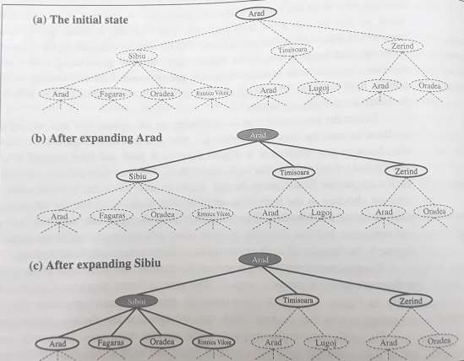
Search Tree – Arad to Bucharest

Slide 24
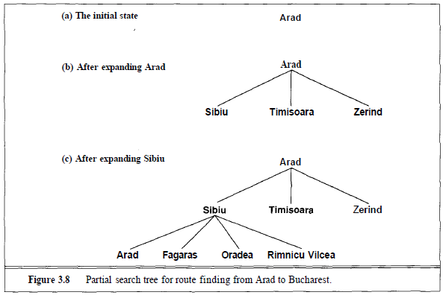
Search Tree – Arad to Bucharest
Pitesti
Bucharest
Bucharest

Slide 25
Traveler's path finding problem
(Travelling Romania)
nodes are states
links are actions

Slide 26


Newnodesgotothebackofthequeue&Oldernodesare expanded first.
_{FIFO queue} O1 O2 N1 N2
1. Completeness–Goalnodeisatafinitedepth‘d’,provided branchingfactor‘b’isfinite.
2. Optimality - Optimalifpathcostisincreasingwithdepthofnode.
Eachnodehas‘b’successors:
Totalno.ofnodesgenerated : $b^{0}+b^{1}+b^{2}+……..+b^{d}=O(b^{d})$
3. TimeComplexity: O(b^{d})
4. Everygenerated noderemainsinmemory:
Space Complexity: O(b^{d})

Slide 27
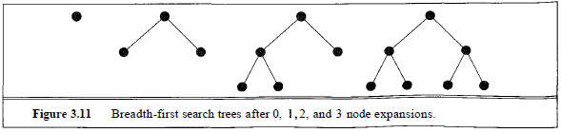
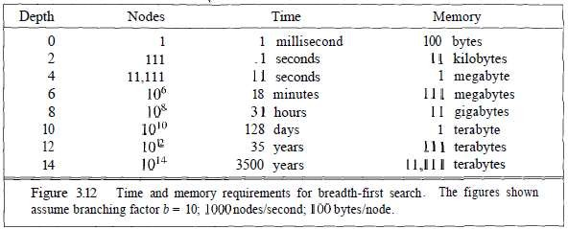
BFS on a Binary tree
Time & Memory Requirements for BFS

Slide 28
BREADTH-FIRST Search
Memory requirements are a bigger problem than Execution time
For problem with depth 12, Petabytes of memory is required
Execution time is still a major factor
350 years for solution for problem with depth 16
Exponential Complexity search problems cannot be solved

Slide 29
Depth-First Search (DFS)
DFS is an algorithm for traversing or searching tree or graph data structures.
Root node of the search tree or some arbitrary node of a graph (r) is expanded first.
All the successors of 'r’ node are expended next & then their successors…so on.
All nodes are expanded in depth rather than expanding the same level and backtrack.
DFS is implemented using LIFO Srack data structure.

Slide 30
Depth-First Search (DFS)
1. Create a variable Node_list and add the root node to Node_list.
2. If the initial state is a goal state quit and return success.
3. Otherwise, do the following until success or failure is signaled.
i. Remove last element from Node_list and call it E.
ii. For every rule which can be applied to E, generate a new state. If there are no more successors signal failure.
iii. Otherwise repeat from step E as the initial state from step 1.
NOTE:
DFS expands the deepest node in the frontier of the search tree
The expanded nodes are then dropped from the frontier
Search “Backs up” to the next deepest node with unexplored successors

Slide 31
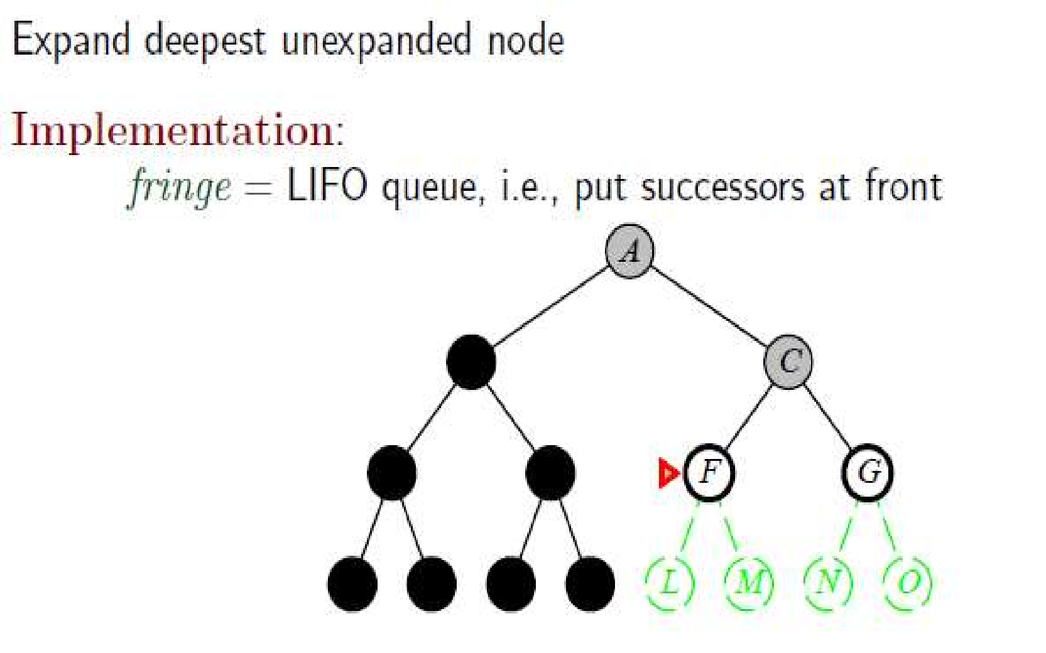
Depth-First Search
Once Expanded, the node is removed from memory & Frontier
Implemented
using LIFO queue

Slide 32
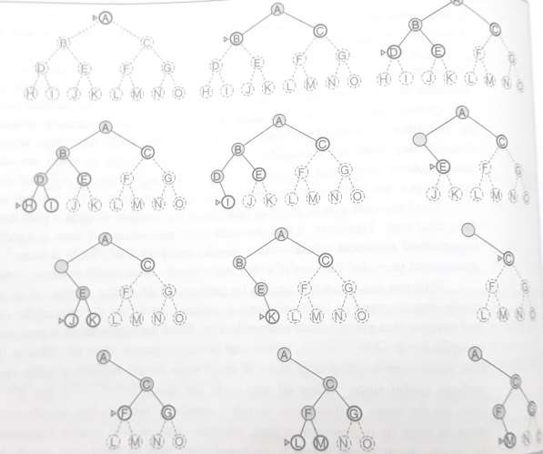
DEPTH-FIRST Search

Slide 33
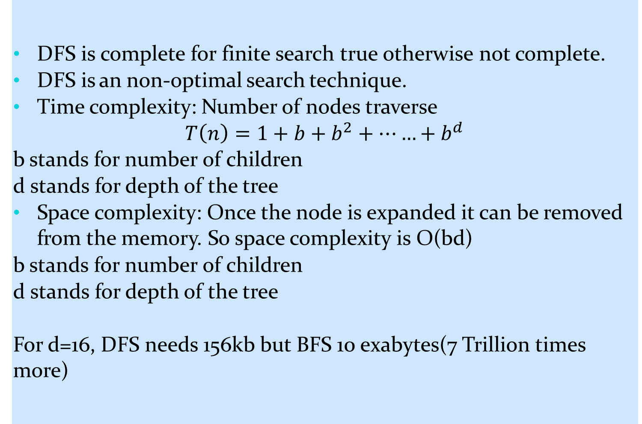
Depth-First Search (DFS)
s

Slide 34
UNIFORM-COST Search
Uniform-cost search expands the node ‘n’ with the lowest path cost g(n) instead of the shallowest node like BFS. Costs of the actions or links are given. When path cost is same then it becomes BFS. It is implemented using priority queue where priority is given having lowest cost. This is also called Dijkstra’s algorithm.
1. Create a variable Node_list and add the root node to Node_list.
2. If the initial state is goal state, quite and return success.
3. Until goal state is found or Node_list empty
i. Remove the element from Node_list and call it E.
ii. For every rule which can be applied to E, generate a new state having lowest cost.
iii. If new state is goal state return and quit.
iv. Else, add the new state to end of Node_list.
4. If Node_list is empty and the goal isn’t found, then failure

Slide 35
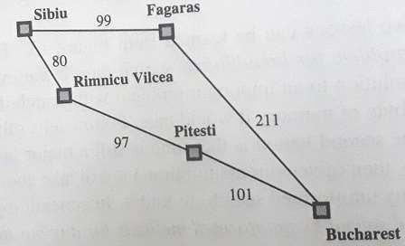
Frontier –Is a priority queue ordered by ‘g’ (Path cost)
Goal Test is applied on node when it is selected for expansion
A Cost Test (path cost calc) is added to check if a better path is found to a node currently in frontier

Slide 36

Depth Limited Search (DLS)
Depth Limited search is a version DFS with a predetermined depth limit of l assumed that no successors exist after level-l.
Features:
For d as the depth, b is the number of children and l as the depth limit.
DLS is incomplete if l < d (shallowest goal is beyond the depth limit)
DLS is non-optimal if l > d
Time complexity $O(b^{l})$
Space Complexity $O(b∗l)$
Ex: Romania has 20 cities with solution length <= 19. So, l = 19 can be chosen

Slide 38
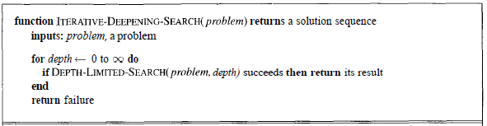
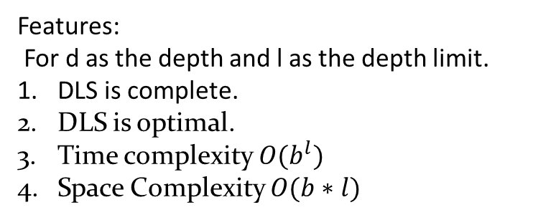
Iterative Deepening Depth-First Search (IDS)
IDS algorithm performs DFS up to a certain depth limit and gradually increasing the limit until a goal is found. This search algorithm combines the benefits of BFS’s fist search and DFS memory efficiency. IDS has to find out best depth limit.
Features:
For d as the depth and l as the depth limit.
DLS is complete.
DLS is optimal.
Time complexity $O(b^{l})$
Space Complexity $O(b∗l)$
Preferred uninformed search method when the search space is large &
depth of the solution is not known

Slide 39


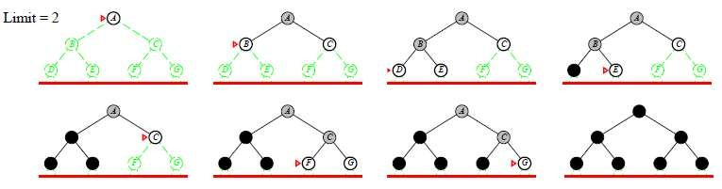
Iterative Deepening Search (ID-DFS): Example

Slide 40
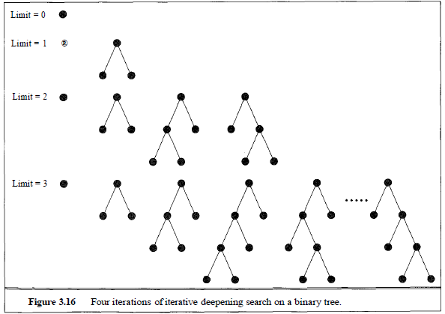
Iterative Deepening Search (ID-DFS):

Slide 41
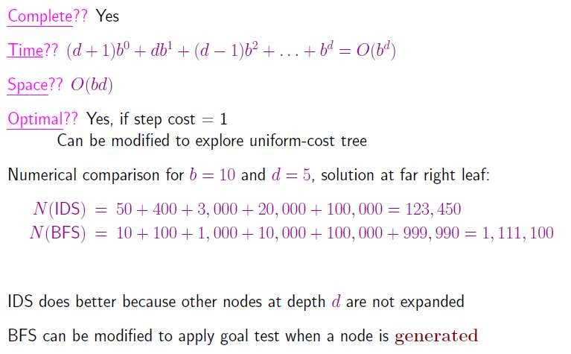
Iterative Deepening Search (ID-DFS): Properties

Slide 42
Bidirectional Search
Idea behind BS
Search “from both ends”
Search “Forward from initial state” & “Backwards from
goal” – till intersect
Analysis
Solution depth (in levels from root, i.e., edge depth): d
b^{i} nodes generated at level i
At least this many nodes to test
Total: Σ_{I} b^{i} = 1 + b + b² + … + b^{d/2} = Ο(b^{d/2})
●
Space Complexity: Ο(b^{d/2}) & Time Complexity: Ο(b^{d/2})

Slide 43
Bidirectional Search
Properties
Space complexity is a weakness of BS
But, Time complexity makes BS attractive
Backward search
8-Puzzle & Romania problems have only one goal state
(backward search is similar to forward search)
In case of many goal states a new dummy goal state is
created (predecessor to all goal states)

Slide 44

48

